Slide 1
GCBASIC
PIC16Fxxxx chip Family ( Legacy )
Part 12 - GLCD Operations using I2C

Slide 2
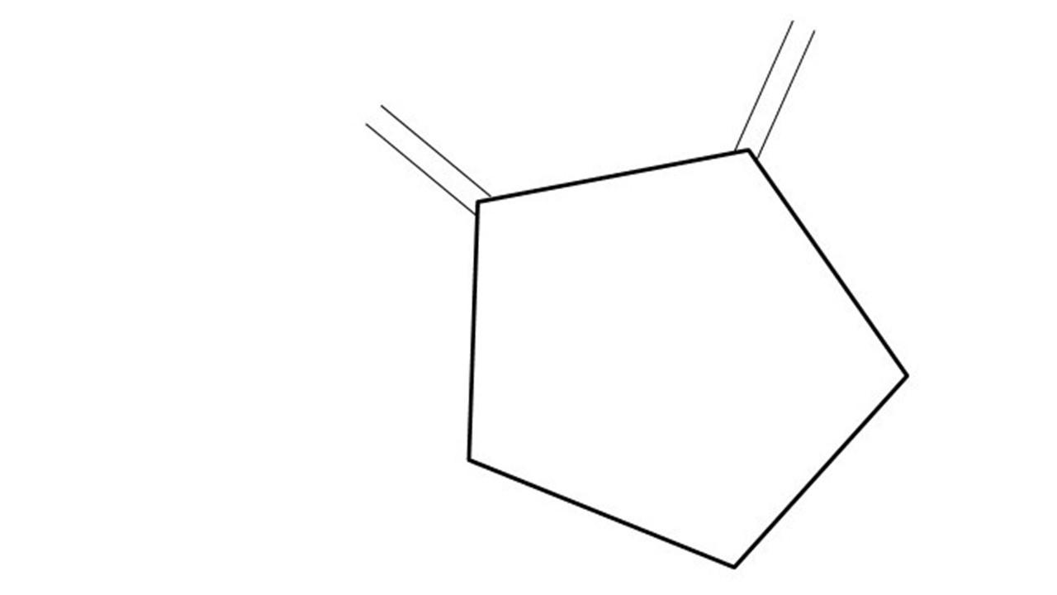
GCBASIC
PIC16Fxxxx chip Family ( Legacy )
Part 12 - GLCD Operations using I2C
January 2025

Slide 3
GCBASIC
Like and subscribe!

Slide 4
PIC16Fxxxx
PIC16Fxxxx is a high performance PIC16
Digital and Analog peripherals
8 –bit or 10-bit ADC
Multiple communication interfaces
Serial, I2C and SPI
PWM – CCP/PWM and 16Bit
The PIC16 offers 8, 14,18,20, 28, 40 and 48-pin packages to support customers in a wide variety of applications.

Slide 5
Videos...
Install the hardware and make the board work – make LEDs work
Make four LEDs flash in a sequence
Set the LEDs to represent the value of ADC
Sequence the LEDs with a delay using the value of ADC
Using an input to set the state of the LEDs
Using the reset switch
Using the switch, ADC – make the LEDs flash in a sequence with reverse
Using the serial to display values
Using the timer0 overflow, 8bit timer, 16bit timer to flash the LEDs
Using EEProm – showing values on the serial terminal, and more constants insights
Using I2C with serial to discover I2C devices
Using an I2C GCLD display
Using a SPI GCLD display
Using PWM, many ways, to dim the LEDS
Using an external interrupt to control an LED
Using storage within the chip – Progmem, EEPROM and DATA blocks
The GCBASIC tool chain
Assembly , alternatives assemblers and MPLAB-X
Summary

Slide 6
GCBASIC Compiler
GCBASIC Compiler
GCBASIC is an Open Source compiler for PIC, AVR and LGT microcontrollers
GCBASIC supports the 16Fxxxx chip family

Slide 7
Prerequisites
Assumes you have
Installed the GCBASIC software
Installed your programmer software
Test that you have the PIC attached
You have the 4 LEDs operating
You have a POT connected
You have switches connected
You have USB/TTL serial converter
You have LCD
You have a i2C SSD1306 GLCD

Slide 8
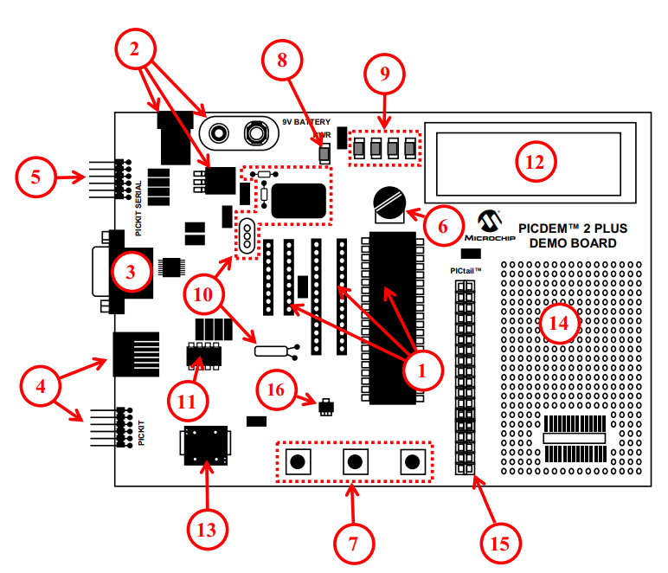
Hardware
The PICDEM 2 Plus Demonstration Board
18-, 28- and 40-pin DIP sockets (although three sockets are provided, only one device may be used at a time)
On-board, +5V regulator for direct input from 9V, 100 mA AC/DC wall adapter or 9V battery, or hooks for a +5V, 100 mA regulated DC supply
RS-232 socket and associated hardware for direct connection to an RS-232 interface
Programmer/debugger connectivity supporting MPLAB® ICD 3, MPLAB REAL ICE, PICkit 2 and PICkit 3
PICkit Serial Connector for analysis of serial communications peripherals such as SPI or I2C™
5 k pot for devices with analog inputs
Three push button switches for external stimulus and Reset
Power-on indicator LED
Four LEDs connected to PORTB
On-board external oscillators including: a) Unpopulated DIP socket for canned crystal oscillator (Y2) b) RC oscillator circuit (R4, C3) c) Unpopulated holes for crystal connection (Y1) d) 32.768 kHz crystal for Timer1 clock operation (Y3)
32K x 8 Serial EEPROM
LCD display
Piezo buzzer
Prototype area for user hardware
Expansion Header for PICtail™ daughter card connectivity or user access to
MCUs
Microchip TC74 thermal sensor

Slide 9
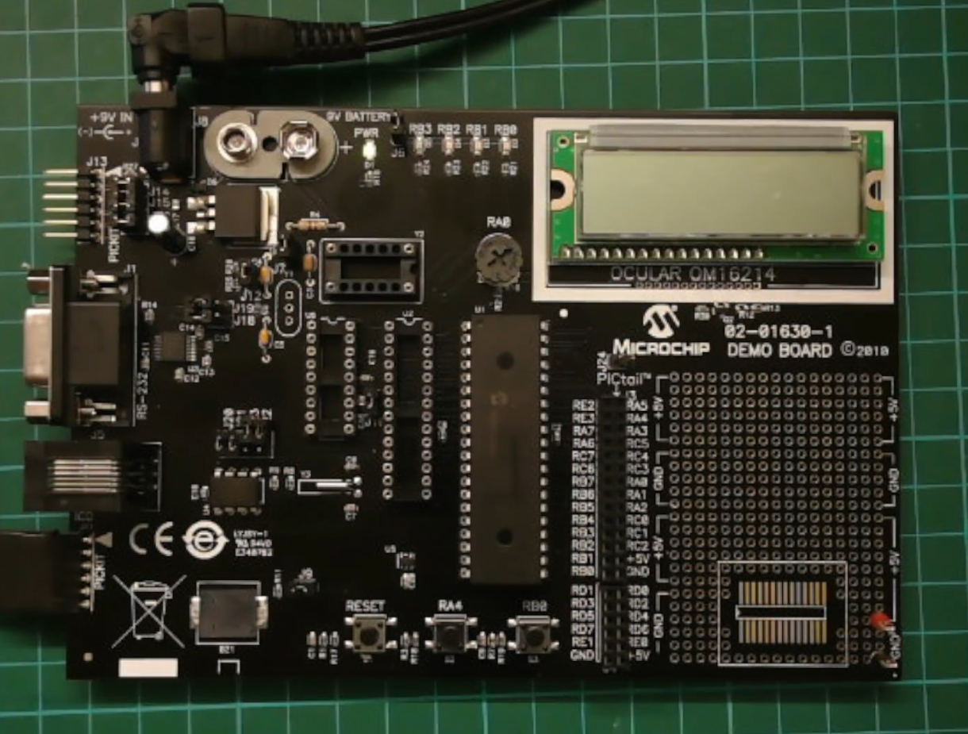

Slide 10
Hardware
Hardware
------------PORTA---------------
Bit#: -7---6---5---4---3---2---1---0---
IO: ------------SW2-------------ADC--
IO: ---------------------------------
------------PORTB----------------
Bit#: -7---6---5---4---3---2---1---0---
IO: ----------------LED-LED-LED-LED--
IO: ---------------------------------
------------PORTC----------------
Bit#: -7---6---5---4---3---2---1---0---
IO: -----TX-----SDA-SCL---------------
IO: ---------------------------------
------------PORTD----------------
Bit#: -7---6---5---4---3---2---1---0---
IO: -PWR-EN--RW--RS--DB7-DB6-DB5-DB4-
IO: ---------------------------------
------------PORTE----------------
Bit#: -7---6---5---4---3---2---1---0---
IO: ----------------RST---------------
IO: ---------------------------------
Prototype Board
Power 5v0
Programmer
LEDs & resistors
Switches
TTL/USB
LCD
GLCD

Slide 11
I²C
I²C uses two bidirectional open collector or open drain lines pulled up with resistors
Serial Data Line (SDA)
Serial Clock Line (SCL)
Typical voltages used are +5 V or +3.3 V, although systems with other voltages are permitted

Slide 12
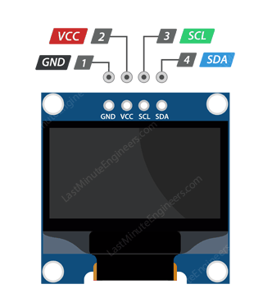
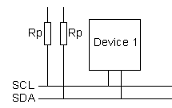
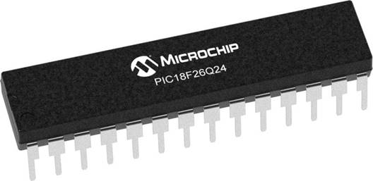
Setup
VCC
CLOCK
---------
SCL
DATA
---------
SDA

Slide 13
I2C sequence
i2cStart
i2cSend Address
i2cSend
Data
i2cStop
Start Condition:
Indicated by a high-to-low transition on the SDA line while SCL is high.
This signals the beginning of communication.
Send (Address):
Master sends the address of the slave device including by the Read/Write bit.
Slave responds with an Acknowledgment (ACK) bit.
Send (Data):
Master sends or receives data bytes.
Each byte is followed by an Acknowledgment (ACK) from the receiver.
Stop Condition:
Indicated by a low-to-high transition on the SDA line while SCL is high.
This signals the end of communication.

Slide 14
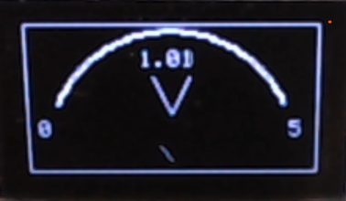
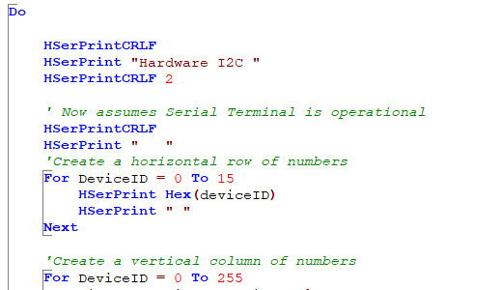
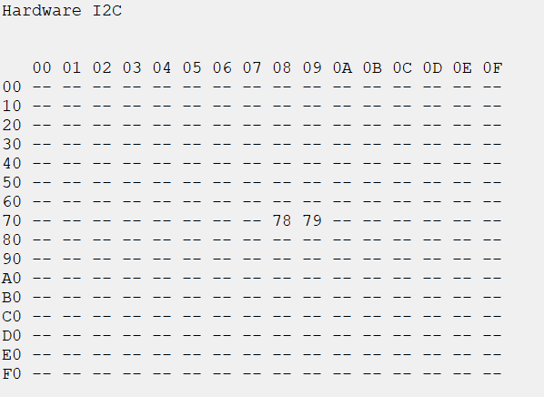
I²C
I2C Discovery

Slide 15
User Program
User Functions
External Sources
DB, BMP, Version control…
Converters
r
7 segment, GLCD, Maths…
Libraries - 125
r
USART, I2C, SPI….
Lowlevel - 26
Microcontroller specific solution (.HEX)

Slide 16
Lab
Examine the sample code
Set up the I²C
Review demonstrations and see the results
Focus | Shows
128x32 & 128x64 capability demos | Primitives Memory usage & Transactions
BMP converter | Converter
Sprite | Expose buffer and custom I2C subroutine
Voltmeter | Trig2places & Low level GLCD commands

Slide 18
Videos...
Install the hardware and make the board work – make LEDs work
Make four LEDs flash in a sequence
Set the LEDs to represent the value of ADC
Sequence the LEDs with a delay using the value of ADC
Using an input to set the state of the LEDs
Using the reset switch
Using the switch, ADC – make the LEDs flash in a sequence with reverse
Using the serial to display values
Using the timer0 overflow, 8bit timer, 16bit timer to flash the LEDs
Using EEProm – showing values on the serial terminal, and more constants insights
Using I2C with serial to discover I2C devices
Using an I2C GCLD display
Using a SPI GCLD display
Using PWM, many ways, to dim the LEDS
Using an external interrupt to control an LED
Using storage within the chip – Progmem, EEPROM and DATA blocks
The GCBASIC tool chain
Assembly , alternatives assemblers and MPLAB-X
Summary

Slide 19
GCBASIC
PIC16Fxxxx chip Family ( Legacy )
Part 12 - GLCD Operations using I2C

